Slide 1
Advanced Java Concepts

Slide 2
Object File I/O
It is possible to store objects just as easily as you store primitive data values.
We use ObjectOutputStream and ObjectInputStream to save to and load objects from a file.
To save objects from a given class, the class declaration must include the phrase implements Serializable. For example,
class Person implements Serializable {
. . .
}

Slide 3
Saving Objects
File outFile
= new File("objects.data");
FileOutputStream outFileStream
= new FileOutputStream(outFile);
ObjectOutputStream outObjectStream
= new ObjectOutputStream(outFileStream);
Person person = new Person("Mr. Espresso", 20, 'M');
outObjectStream.writeObject( person );
account1 = new Account();
bank1 = new Bank();
outObjectStream.writeObject( account1 );
outObjectStream.writeObject( bank1 );
Could save objects from the different classes.
Notes:
You can even mix objects and primitive data type values. For example,
outObjectStream.writeInt ( 15 );
outObjectStream.writeObject( account1 );
outObjectStream.writeChar ( 'X' );

Slide 4
Reading Objects
File inFile
= new File("objects.data");
FileInputStream inFileStream
= new FileInputStream(inFile);
ObjectInputStream inObjectStream
= new ObjectInputStream(inFileStream);
Person person
= (Person) inObjectStream.readObject( );
Must type cast to the correct object type.
Account account1
= (Account) inObjectStream.readObject( );
Bank bank1
= (Bank) inObjectStream.readObject( );
Must read in the correct order.
Notes:
You can even mix objects and primitive data type values. For example,
outObjectStream.writeInt ( 15 );
outObjectStream.writeObject( account1 );
outObjectStream.writeChar ( 'X' );

Slide 5
Saving and Loading Arrays
Instead of processing array elements individually, it is possible to save and load the whole array at once.
Person[] people = new Person[ N ];
//assume N already has a value
//build the people array
. . .
//save the array
outObjectStream.writeObject ( people );
//read the array
Person[ ] people = (Person[]) inObjectStream.readObject( );
Notes:
class FindSum
{
private int sum;
private boolean success;
public int getSum()
{
return sum;
}
public boolean isSuccess()
{
return success;
}
void computeSum (String fileName )
{
success = true;
try {
File inFile = new File(fileName);
FileInputStream inFileStream
= new FileInputStream(inFile);
DataInputStream inDataStream
= new DataInputStream(inFileStream);
//read three integers
int i = inDataStream.readInt();
int j = inDataStream.readInt();
int k = inDataStream.readInt();
sum = i + j + k;
inDataStream.close();
}
catch (IOException e) {
success = false;
}
}
}

Slide 6
clone() Method
To use clone() must implement Cloneable
Object.clone() is automatically inherited by every class
by default, it creates a new object and copies all fields
Example
Foo f1 = new Foo(5);
Foo f2 = f1.clone();
f2.setNum(10);
System.out.println(“f1’s num = “ + f1.getNum()); // prints 5
System.out.println(“f2’s num = “ + f2.getNum()); // prints 10

Slide 7
Shallow Clone
Only copies the fields
does not copy what the fields reference
Doesn’t work well for sophisticated objects
Example:
Class Foo {
private int [] nums;
public void Foo(int size) { nums = new int[size]; }
…
}
Foo f1 = new Foo(5);
Foo f2 = f1.clone();

Slide 8
Shallow Clone
Foo f1 = new Foo(5);
Foo f2 = f1.clone();
nums = 50
func1
f1 = 200
f2 = 100
200
Array
50
nums = 50
100
Stack
Heap

Slide 9
Deep Clone
Copies fields and what they refer to
Must reimplement the clone() method
class Foo {
…
public Object clone() {
try {
Foo fobj = (Foo)super.clone(); // copies fields
fobj.nums = (int)nums.clone(); // arrays implement clone
return fobj;
} catch(CloneNotSupportedException e) { }
}
}

Slide 10
Threads
Threads allow the program to run tasks in parallel
In many cases threads need to be synchronized, that is, be kept not to handle the same data in memory concurrently
There are cases in which a thread needs to wait for another thread before proceeding

Slide 11
Threads in Java
public class PrintNumbers {
static public void printNumbers() {
for(int i=0; i<1000; i++) {
System.out.println(
Thread.currentThread().getId() +
": " + i);
}
}
}

Slide 12
Threads in Java
public class Thread1 extends Thread {
@Override
public void run() {
System.out.println("Thread1 ThreadId: " + Thread.currentThread().getId());
// do our thing
PrintNumbers.printNumbers();
// the super doesn't anything,
// but just for the courtesy and good practice
super.run();
}
}

Slide 13
extending class Thread:
public class Thread1 extends Thread {
@Override
public void run() {
System.out.println("Thread1 ThreadId: " + Thread.currentThread().getId());
// do our thing
PrintNumbers.printNumbers();
// the super doesn't anything,
// but just for the courtesy and good practice
super.run();
}
}

Slide 14
extending class Thread(cont):
static public void main(String[] args) {
System.out.println("Main ThreadId: " + Thread.currentThread().getId());
for(int i=0; i<3; i++) {
new Thread1().start(); // don't call run! // (if you want a separate thread)
}
printNumbers();
}

Slide 15
implementing Runnable
public class Thread2 implements Runnable {
@Override
public void run() {
System.out.println("Thread2 ThreadId: " + Thread.currentThread().getId());
// do our thing
PrintNumbers.printNumbers();
}
}

Slide 16
implementing Runnable(cont)
static public void main(String[] args) {
System.out.println("Main ThreadId: " + Thread.currentThread().getId());
for(int i=0; i<3; i++) {
new Thread(new Thread2()).start();
// again, don't call run!
// (if you want a separate thread)
}
printNumbers();
}

Slide 17
implementing Runnable as Anonymous
static public void main(String[] args) {
System.out.println("Main ThreadId: " + Thread.currentThread().getId());
new Thread(new Runnable() {
@Override
public void run() {
System.out.println("Thread3 ThreadId: " + Thread.currentThread().getId());
// do our thing
printNumbers();
}
}).start(); // don't call run! ...
printNumbers();
}

Slide 18
Thread States

Slide 19
Synchronization
Threads allow the program to run tasks in parallel
Synchronization of threads is needed for in order to control threads coordination, mainly in order to prevent simultaneous operations on data
For simple synchronization Java provides the synchronized keyword

Slide 20
synchronizing methods
public class SynchronizedCounter {
private int c = 0;
public synchronized void increment() { c++; }
public synchronized void decrement() { c--; }
public synchronized int value() { return c; }
}
The synchronized keyword on a method means that if this is already locked anywhere (on this method or elsewhere) by another thread, we need to wait till
this is unlocked before entering the method

Slide 21
synchronizing blocks
public void addName(String name) {
synchronized(this) {
lastName = name;
nameCount++;
}
nameList.add(name);
}
When synchronizing a block, key for the locking should be supplied (usually would be this) The advantage of not synchronizing the entire method is efficiency

Slide 22
synchronizing blocks
public class Drop {
...
public synchronized String take() {
// Wait until message is available
while (empty) {
// we do nothing on InterruptedException
// since the while condition is checked anyhow try { wait(); }
catch (InterruptedException e) {}
}
// Toggle status and notify on the status change
empty = true;
notifyAll();
return message;
}
...
}

Slide 23
wait(), notify(), notifyAll()
wait() and notify() allows a thread to wait for an event
A call to notifyAll() allows all threads that are on wait() with the same lock to be released
A call to notify() allows one arbitrary thread that is on a wait() with the same lock to be released

Slide 24
Annotations
Annotations are metadata or data about data. An annotation indicates that the declared element should be processed in some special way by a compiler, development tool, deployment tool, or during runtime.
Annotation-based development is certainly one of the latest Java development trends
Annotations can be applied to several Java Elements like,
package declarations,
class,
constructors,
methods,
fields,
Variables and etc.

Slide 25
The Basics
Example to Define an Annotation (Annotation type)
public @interface MyAnnotation {
String doSomething();
}
Example to Annotate Your Code (Annotation)
MyAnnotation (doSomething="What to do")
public void mymethod() {
.......
}

Slide 26


Structure of Java Compiler
Parser
Type
Checker
Class File
Writer
Source File
class C {
@NonNull
Object field;
C(@NonNull
Object p) {
field = p;
}
@NonNull
Object get() {
return field;
}
}
Class
File
Comments
Error

Slide 27
Structure of Java5 Compiler
Parser
Type
Checker
Annotation
Checker
Class File
Writer
Source File
class C {
@NonNull
Object field;
C(@NonNull
Object p) {
field = p;
}
@NonNull
Object get() {
return field;
}
}
Class
File
Program
with
annotations
Error
Error
Annotation
Checker
Plugins

Slide 28
Annotation Types
Marker
Single-Element
Full-value or multi-value

Slide 29
Marker
Marker annotations take no parameters. They are used to mark a Java element to be processed in a particular way.
Example:
public @interface MyAnnotation {
}
Usage:
@MyAnnotation
public void mymethod() {
....
}

Slide 30
Single-Element
Single-element, or single-value type, annotations provide a single piece of data only. This can be represented with a data=value pair or, simply with the value (a shortcut syntax) only, within parenthesis.
Example:
public @interface MyAnnotation {
String doSomething();
}
Usage:
@MyAnnotation ("What to do")
public void mymethod() {
....
}

Slide 31
Full-value or multi-value
Full-value type annotations have multiple data members.
Example:
public @interface MyAnnotation {
String doSomething();
int count;
String date();
}
Usage:
@MyAnnotation (doSomething=
"What to do",
count=1,
date="09-09-2005")
public void mymethod() {
....
}

Slide 32
Example
@Retention(RetentionPolicy.RUNTIME)
@Target(METHOD)
public @interface MyAnnotation {
String value();
}
public class HelloAnnotation {
@MyAnnotation(value="Hello")
public void sayHello() {
System.out.println("Say Hello!");
}
public static void main(String[] args) throws
NoSuchMethodException, SecurityException {
HelloAnnotation helloAnnotation = new HelloAnnotation();
Method method = helloAnnotation.getClass().getMethod("sayHello");
System.out.println(method);
MyAnnotation myAnnotation = method.getAnnotation(MyAnnotation.class);
System.out.println("Printing Value:"+ myAnnotation.value());
}
}

Slide 33
The Built-In Annotations
Java defines seven built-in annotations.
Four are imported from java.lang.annotation
@Retention,
@Documented,
@Target,
and @Inherited.
Three are included in java.lang.
@Override,
@Deprecated,
and @SuppressWarnings.

Slide 34
Simple Annotations (or) Standard Annotations
There are three types of simple annotations provided by JDK5.
They are:
Override
Deprecated
Suppresswarnings

Slide 35
Override
Override is a Marker Annotation type that can be applied to a method to indicate to the Compiler that the method overrides a method in a Superclass. This Annotation type guards the programmer against making a mistake when overriding a method. For eg The syntax ---@Override
Example Program:
class Parent { public float calculate (float a, float b) { return a * b; } } Whenever you want to override a method, declare the Override annotation type before the method: public class Child extends Parent { @Override public int calculate (int a, int b) { return (a + 1) * b; } }

Slide 36
The Deprecated annotation
This annotation indicates that when a deprecated program element is used, the compiler should warn you about it. Example 2 shows you the deprecated annotation.
The syntax --- @Deprecated
Example :
public class DeprecatedTest { @Deprecated public void serve() { } }
If you use or override a deprecated method, you will get a warning at compile time.
public class DeprecatedTest2 { public static void main(String[] args) { DeprecatedTest test = new DeprecatedTest(); test.serve(); } }

Slide 37
The Suppresswarnings annotation
SuppressWarnings is used to suppress compiler warnings. You
can apply @SuppressWarnings to types, constructors, methods,
fields, parameters, and local variables.
The syntax --- @SuppressWarnings
Eg:
import java.util.Date; public class Main { @SuppressWarnings(value={"deprecation"}) public static void main(String[] args) { Date date = new Date(2009, 9, 30); System.out.println("date = " + date); } }

Slide 38
The Target annotation
@Target(ElementType.TYPE)—can be applied to any element of a class
@Target(ElementType.FIELD)—can be applied to a field or property
@Target(ElementType.METHOD)—can be applied to a method level annotation
@Target(ElementType.PARAMETER)—can be applied to the parameters of a method
@Target(ElementType.CONSTRUCTOR)—can be applied to constructors
@Target(ElementType.LOCAL_VARIABLE)—can be applied to local variables
@Target(ElementType.ANNOTATION_TYPE)—indicates that the declared type itself is an

Slide 39
Java 8+
Introduces
Default Methods
Functional Interfaces
Lambda Expressions
Stream API and overall improvements to Collections to support Streams

Slide 40
Default Methods
In Context of Support For Streams
Java 8 needed to add functionality to existing Collection interfaces to support Streams (stream(), forEach())

Slide 41
Default Methods
Problem
Pre-Java 8 interfaces couldn’t have method bodies.
The only way to add functionality to Interfaces was to declare additional methods which would be implemented in classes that implement the interface
It is impossible to add methods to an interface without breaking the existing implementation

Slide 42
Default Methods
Solution
Default Methods!
Java 8 allows default methods to be added to interfaces with their full implementation
Classes which implement the interface don’t have to have implementations of the default method
Allows the addition of functionality to interfaces while preserving backward compatibility

Slide 43
Default Methods
FooA.java
public interface FooA {
default void printFooA(){
System.out.println("Hi this is default Foo A!");
}}
DefaultMethodsTest.java
public class DefaultMethodsTest implements FooA {
public DefaultMethodsTest() {
this.printFooA();
}
public static void main(String[] args) {
new DefaultMethodsTest();
}
}

Slide 44
Multiple Default Methods
Vehicle.java
public interface Vehicle {
default void print() {
System.out.println("I am a vehicle!");
}
}
FourWheeler.java
public interface FourWheeler {
default void print() {
System.out.println("I am a four wheeler!");
}
}

Slide 45
Multiple Default Methods
Duplicate default methods named print with the parameters () and () are inherited from the types FourWheeler and Vehicle
Car.java
public class Car implements Vehicle, FourWheeler {
public void print() {
System.out.println("I am a four wheeler car vehicle!");
}
}
OR
Car.java
public interface FourWheeler {
public void print() {
// Vehicle.super.print();
FourWheeler.super.print();
}
}

Slide 46
Functional Interfaces
Interfaces with only one abstract method.
With only one abstract method, these interfaces can be easily represented with lambda expressions
@FunctionalInterface
public interface MathOperation {
int operation(int a, int b);
}

Slide 47
Lambda expressions
A lambda expression is characterized by the following syntax.
parameter -> expression body
Following are the important characteristics of a lambda expression.
Optional type declaration − No need to declare the type of a parameter. The compiler can inference the same from the value of the parameter.
Optional parenthesis around parameter − No need to declare a single parameter in parenthesis. For multiple parameters, parentheses are required.
Optional curly braces − No need to use curly braces in expression body if the body contains a single statement.
Optional return keyword − The compiler automatically returns the value if the body has a single expression to return the value. Curly braces are required to indicate that expression returns a value.

Slide 48
Lambda expressions
public class LambdaTest{
public static void main(String args[]) {
LambdaTest tester = new LambdaTest();
//with type declaration
MathOperation addition = (int a, int b) -> a + b;
//with out type declaration
MathOperation subtraction = (a, b) -> a - b;
//with return statement along with curly braces
MathOperation multiplication = (int a, int b) -> { return a * b; };
//without return statement and without curly braces
MathOperation division = (int a, int b) -> a / b;
System.out.println("10 + 5 = " + tester.operate(10, 5, addition));
System.out.println("10 - 5 = " + tester.operate(10, 5, subtraction));
System.out.println("10 x 5 = " + tester.operate(10, 5, multiplication));
System.out.println("10 / 5 = " + tester.operate(10, 5, division));
}
private int operate(int a, int b, MathOperation mathOperation) {
return mathOperation.operation(a, b);
}
}
Notes:
public class LambdaTest{
public static void main(String args[]) {
LambdaTest tester = new LambdaTest();
//with type declaration
MathOperation addition = (int a, int b) -> a + b;
//with out type declaration
MathOperation subtraction = (a, b) -> a - b;
//with return statement along with curly braces
MathOperation multiplication = (int a, int b) -> { return a * b; };
//without return statement and without curly braces
MathOperation division = (int a, int b) -> a / b;
System.out.println("10 + 5 = " + tester.operate(10, 5, addition));
System.out.println("10 - 5 = " + tester.operate(10, 5, subtraction));
System.out.println("10 x 5 = " + tester.operate(10, 5, multiplication));
System.out.println("10 / 5 = " + tester.operate(10, 5, division));
}
private int operate(int a, int b, MathOperation mathOperation) {
return mathOperation.operation(a, b);
}
}

Slide 49
Java Lambda Expressions
Lambda expression is a new and important feature of Java which was included in Java SE 8. It provides a clear and concise way to represent one method interface using an expression. It is very useful in collection library. It helps to iterate, filter and extract data from collection.
Java lambda expression is treated as a function, so compiler does not create .class file.
Functional Interface
Lambda expression provides implementation of functional interface. An interface which has only one abstract method is called functional interface. Java provides an annotation @FunctionalInterface, which is used to declare an interface as functional interface.

Slide 50
Java Lambda Syntax
(argument-list) -> {body}
Java lambda expression is consisted of three components.
1) Argument-list: It can be empty or non-empty as well.
2) Arrow-token: It is used to link arguments-list and body of expression.
3) Body: It contains expressions and statements for lambda expression.

Slide 51
Before Lambda Example
interface Drawable{
public void draw();
}
public class BeforeLamdba {
public static void main(String[] args) {
int width=10;
//without lambda, Drawable implementation using anonymous class
Drawable d=new Drawable(){
public void draw(){System.out.println("Drawing "+width);}
};
d.draw();
}
}

Slide 52
With Lambda
@FunctionalInterface //It is optional
interface Drawable{
public void draw();
}
public class LambdaExpression {
public static void main(String[] args) {
int width=10;
//with lambda
Drawable d2=()->{
System.out.println("Drawing "+width);
};
d2.draw();
}
}

Slide 53
Lambda Example with Multi Params
interface Addable{
int add(int a,int b);
}
public class LambdaExpressionExample5{
public static void main(String[] args) {
// Multiple parameters in lambda expression
Addable ad1=(a,b)->(a+b);
System.out.println(ad1.add(10,20));
// Multiple parameters with data type in lambda expression
Addable ad2=(int a,int b)->(a+b);
System.out.println(ad2.add(100,200));
}
}

Slide 54
Method References
Method references help to point to methods by their names. A method reference is described using "::" symbol. A method reference can be used to point the following types of methods −
Static methods
Instance methods
Constructors using new operator (TreeSet::new)
public class MethodReferenceTest {
public static void main(String args[]) {
List<String> names = new ArrayList<String>();
names.add("John");
names.add("Jack");
names.add("Jill");
names.forEach(System.out::println);
}
}
Notes:
public class MethodReferenceTest {
public static void main(String args[]) {
List<String> names = new ArrayList<String>();
names.add("John");
names.add("Jack");
names.add("Jill");
names.forEach(System.out::println);
}
}

Slide 55
Method References
Method references help to point to methods by their names. A method reference is described using "::" symbol. A method reference can be used to point the following types of methods −
Static methods
Instance methods
Constructors using new operator (TreeSet::new)
Notes:
public class MethodReferenceTest {
public static void main(String args[]) {
List<String> names = new ArrayList<String>();
names.add("John");
names.add("Jack");
names.add("Jill");
names.forEach(System.out::println);
}
}

Slide 56
Streams
Stream represents a sequence of objects from a source, which supports aggregate operations. Following are the characteristics of a Stream −
Sequence of elements − A stream provides a set of elements of specific type in a sequential manner. A stream gets/computes elements on demand. It never stores the elements.
Source − Stream takes Collections, Arrays, or I/O resources as input source.
Aggregate operations − Stream supports aggregate operations like filter, map, limit, reduce, find, match, and so on.
Pipelining − Most of the stream operations return stream itself so that their result can be pipelined. These operations are called intermediate operations and their function is to take input, process them, and return output to the target. collect() method is a terminal operation which is normally present at the end of the pipelining operation to mark the end of the stream.
Automatic iterations − Stream operations do the iterations internally over the source elements provided, in contrast to Collections where explicit iteration is required.

Slide 57
Characteristics of Streams
Streams are not related to InputStreams, OutputStreams, etc.
Streams are NOT data structures but are wrappers around Collection that carry values from a source through a pipeline of operations.
Streams are more powerful, faster and more memory efficient than Lists
Streams are designed for lambdas
Streams can easily be output as arrays or lists
Streams employ lazy evaluation
Streams are parallelizable
Streams can be “on-the-fly”

Slide 58
Generating Streams
With Java 8, Collection interface has two methods to generate a Stream.
stream() − Returns a sequential stream considering collection as its source.
parallelStream() − Returns a parallel Stream considering collection as its source.

Slide 59
Creating Streams
From individual values
Stream.of(val1, val2, …)
From array
Stream.of(someArray)
Arrays.stream(someArray)
From List (and other Collections)
someList.stream()
someOtherCollection.stream()
public class Snippet {
public static void main(String[] args) {
List<String> strings = Arrays.asList("abc", "", "bc", "efg", "abcd", "", "jkl");
List<String> filtered = strings.stream()
.filter(string -> !string.isEmpty())
.collect(Collectors.toList());
filtered.forEach(System.out::println);
}
}
Notes:
import java.util.Arrays;
import java.util.List;
import java.util.stream.Collectors;
public class Snippet {
public static void main(String[] args) {
List<String> strings = Arrays.asList("abc", "", "bc", "efg", "abcd", "", "jkl");
List<String> filtered = strings.stream()
.filter(string -> !string.isEmpty())
.collect(Collectors.toList());
filtered.forEach(System.out::println);
}
}

Slide 60
Anatomy of the Stream Pipeline
A Stream is processed through a pipeline of operations
A Stream starts with a source data structure
Intermediate methods are performed on the Stream elements. These methods produce Streams and are not processed until the terminal method is called.
The Stream is considered consumed when a terminal operation is invoked. No other operation can be performed on the Stream elements afterwards
A Stream pipeline contains some short-circuit methods (which could be intermediate or terminal methods) that cause the earlier intermediate methods to be processed only until the short-circuit method can be evaluated.

Slide 61
Anatomy of the Stream Pipeline
Intermediate Methods
map, filter, distinct, sorted, peek, limit,
parallel
Terminal Methods
forEach, toArray, reduce, collect, min,
max, count, anyMatch, allMatch, noneMatch, findFirst, findAny, iterator
Short-circuit Methods
anyMatch, allMatch, noneMatch, findFirst, findAny,limit

Slide 62
Optional<T> Class
A container which may or may not contain a non-null value
Common methods
isPresent() – returns true if value is present
Get() – returns value if present
orElse(T other) – returns value if present, or other
ifPresent(Consumer) – runs the lambda if value is present

Slide 63
Stream forEach
Void forEach(Consumer)
Easy way to loop over Stream elements
You supply a lambda for forEach and that lambda is called on each element of the Stream
Related peek method does the exact same thing, but returns the original Stream

Slide 64
Java 8
Void forEach(Consumer)
Vs. For Loops
List<Employee> employees = getEmployees();
for(Employee e: employees) {
e.setSalary(e.getSalary() * 11/10);
}
Advantages of forEach
Designed for lambdas to be marginally more succinct
Lambdas are reusable
Can be made parallel with minimal effort

Slide 65
Stream map
Stream<T> map(Function)
Produces a new Stream that is the result of applying a Function to each element of original Stream
Example
Ids.map(EmployeeUtils::findEmployeeById)
Create a new Stream of Employee ids

Slide 66
Stream filter
Stream<T> filter(Predicate)
Produces a new Stream that contains only the elements of the original Stream that pass a given test
Example
employees.filter(e -> e.getSalary() > 100000)
Produce a Stream of Employees with a high salary

Slide 67
Stream findFirst
Optional<T> findFirst()
Returns an Optional for the first entry in the Stream
Example
employees.filter(…).findFirst().orElse(Consultant)
Get the first Employee entry that passes the filter

Slide 68
Stream toArray
Object[] toArray(Supplier)
Reads the Stream of elements into a an array
Example
Employee[] empArray = employees.toArray(Employee[]::new);
Create an array of Employees out of the Stream of Employees

Slide 69
Stream collect
List<T> collect(Collectors.toList())
Reads the Stream of elements into a List or any other collection
Example
List<Employee> empList =
employees.collect(Collectors.toList());
Create a List of Employees out of the Stream of Employees

Slide 70
Stream Collect
List<T> collect(Collectors.toList())
partitioningBy
You provide a Predicate. It builds a Map where true maps to a List of entries that passed the Predicate, and false maps to a List that failed the Predicate.
Example
Map<Boolean,List<Employee>> richTable = googlers().collect
(partitioningBy(e -> e.getSalary() > 1000000));
groupingBy
You provide a Function. It builds a Map where each output value of the Function maps to a List of entries that gave that value.
Example
Map<Department,List<Employee>> deptTable =
employeeStream().collect(groupingBy(Employee::getDepartment));

Slide 71
Stream reduce
T reduce(T identity, BinaryOperator)
You start with a seed (identity) value, then combine this value with the first Entry in the Stream, combine the second entry of the Stream, etc.
Example
Nums.stream().reduce(1, (n1,n2) -> n1*n2)
Calculate the product of numbers
IntStream (Stream on primative int] has build-in sum()
Built-in Min, Max methods
Notes:
public class SnippetReduce {
public static void main(String[] args) {
List<String> words = Arrays.asList("GFG", "Geeks", "for",
"GeeksQuiz", "GeeksforGeeks");
// The lambda expression passed to
// reduce() method takes two Strings
// and returns the the longer String.
// The result of the reduce() method is
// an Optional because the list on which
// reduce() is called may be empty.
Optional<String> longestString = words.stream()
.reduce((word1, word2)
-> word1.length() > word2.length()
? word1 : word2);
// Displaying the longest String
longestString.ifPresent(System.out::println);
}
}

Slide 72
Stream limit
Stream<T> limit(long maxSize)
Limit(n) returns a stream of the first n elements
Example
someLongStream.limit(10)
First 10 elements

Slide 73
Stream skip
Stream<T> skip(long n)
skip(n) returns a stream starting with element n
Example
twentyElementStream.skip(5)
Last 15 elements

Slide 74
Stream sorted
Stream<T> sorted(Comparator)
Returns a stream consisting of the elements of this stream, sorted according to the provided Comparator
Example
empStream.map(…).filter(…).limit(…)
.sorted((e1, e2) -> e1.getSalary() - e2.getSalary())
Employees sorted by salary

Slide 75
Stream min
Optional<T> min(Comparator)
Returns the minimum element in this Stream according to the Comparator
Example
Employee alphabeticallyFirst =
ids.stream().map(EmployeeSamples::findGoogler)
.min((e1, e2) ->
e1.getLastName()
.compareTo(e2.getLastName()))
.get();
Get Googler with earliest lastName

Slide 76
Stream max
Optional<T> max(Comparator)
Returns the minimum element in this Stream according to the Comparator
Example
Employee richest =
ids.stream().map(EmployeeSamples::findGoogler)
.max((e1, e2) -> e1.getSalary() -
e2.getSalary()).get();
Get Richest Employee

Slide 77
Stream distinct
Stream<T> distinct()
Returns a stream consisting of the distinct elements of this stream
Example
List<Integer> ids2 =
Arrays.asList(9, 10, 9, 10, 9, 10);
List<Employee> emps4 =
ids2.stream().map(EmployeeSamples::findGoogler)
.distinct()
.collect(toList());
Get a list of distinct Employees

Slide 78
Stream matches
Boolean anyMatch(Predicate), allMatch(Predicate), noneMatch(Predicate)
Returns true if Stream passes, false otherwise
Lazy Evaluation
anyMatch processes elements in the Stream one element at a time until it finds a match according to the Predicate and returns true if it found a match
allMatch processes elements in the Stream one element at a time until it fails a match according to the Predicate and returns false if an element failed the Predicate
noneMatch processes elements in the Stream one element at a time until it finds a match according to the Predicate and returns false if an element matches the Predicate
Example
employeeStream.anyMatch(e -> e.getSalary() > 500000)
Is there a rich Employee among all Employees?

Slide 79
Stream count
long count()
Returns the count of elements in the Stream
Example
employeeStream.filter(somePredicate).count()
How many Employees match the criteria?

Slide 80
Parallel Streams
The Stream API enables developers to create the parallel streams that can take advantage of multi-core architectures and enhance the performance of Java code. In a parallel stream, the operations are executed in parallel and there are two ways to create a parallel stream.
Using the parallelStream() method on a collection
Using the parallel() method on a stream

Slide 81
Parallel Streams
Suppose lets take a scenario of you having a list of employee objects and you have to count employees whose salary is above 15000. Generally, to solve this problem you will iterate over list going through each and every employee and checking if employees salary is above 15000. This takes O(N) time since you go sequentially.
Streams provide us with the flexibility to iterate over the list in a parallel pattern and can give the aggregate in quick fashion.
Stream implementation in Java is by default sequential unless until it is explicitly mentioned for parallel. When a stream executes in parallel, the Java runtime partitions the stream into multiple sub streams. Aggregate operations iterate over and process these sub streams in parallel and then combine the results.
The only thing to keep in mind to create parallel stream is to call parallelStream() on the collection else by default sequential stream gets returned by stream().

Slide 82
Parallel Streams
class Employee {
private int salary;
private String name;
Employee(String name, int salary) {
this.name = name;
this.salary = salary;
}
//getter and setters
}
Notes:
class Employee {
private int salary;
private String name;
Employee(String name, int salary) {
this.name = name;
this.salary = salary;
}
public int getSalary() {
return salary;
}
public void setSalary(int salary) {
this.salary = salary;
}
public String getName() {
return name;
}
public void setName(String name) {
this.name = name;
}
}

Slide 83
Parallel Streams
public class ParallelStream {
public static void main(String[] args) {
List < Employee > empList = new ArrayList < Employee > ();
for (int i = 0; i < 300; i++) {
empList.add(new Employee("A", 20000));
empList.add(new Employee("B", 3000));
empList.add(new Employee("C", 15002));
empList.add(new Employee("D", 7856));
empList.add(new Employee("E", 200));
empList.add(new Employee("F", 50000));
}
long t1 = System.currentTimeMillis();
System.out.println("Sequential Stream count: " + empList.stream()
.filter(e -> e.getSalary() > 15000).count());
long t2 = System.currentTimeMillis();
System.out.println("Sequential Stream Time taken:" + (t2 - t1));
t1 = System.currentTimeMillis();
System.out.println("Parallel Stream count: " + empList.parallelStream()
.filter(e -> e.getSalary() > 15000).count());
t2 = System.currentTimeMillis();
System.out.println("Parallel Stream Time taken:" + (t2 - t1));
}
}
Notes:
import java.util.ArrayList;
import java.util.List;
public class ParallelStream {
public static void main(String[] args) {
List < Employee > empList = new ArrayList < Employee > ();
for (int i = 0; i < 300; i++) {
empList.add(new Employee("A", 20000));
empList.add(new Employee("B", 3000));
empList.add(new Employee("C", 15002));
empList.add(new Employee("D", 7856));
empList.add(new Employee("E", 200));
empList.add(new Employee("F", 50000));
}
long t1 = System.currentTimeMillis();
System.out.println("Sequential Stream count: " + empList.stream().filter(e -> e.getSalary() > 15000).count());
long t2 = System.currentTimeMillis();
System.out.println("Sequential Stream Time taken:" + (t2 - t1));
t1 = System.currentTimeMillis();
System.out.println("Parallel Stream count: " + empList.parallelStream().filter(e -> e.getSalary() > 15000).count());
t2 = System.currentTimeMillis();
System.out.println("Parallel Stream Time taken:" + (t2 - t1));
}
}

Slide 84
Parallel Streams
Sequential Stream count: 900
Sequential Stream Time taken:21
Parallel Stream count: 900
Parallel Stream Time taken:10
Notes:
import java.util.ArrayList;
import java.util.List;
public class ParallelStream {
public static void main(String[] args) {
List < Employee > empList = new ArrayList < Employee > ();
for (int i = 0; i < 300; i++) {
empList.add(new Employee("A", 20000));
empList.add(new Employee("B", 3000));
empList.add(new Employee("C", 15002));
empList.add(new Employee("D", 7856));
empList.add(new Employee("E", 200));
empList.add(new Employee("F", 50000));
}
long t1 = System.currentTimeMillis();
System.out.println("Sequential Stream count: " + empList.stream().filter(e -> e.getSalary() > 15000).count());
long t2 = System.currentTimeMillis();
System.out.println("Sequential Stream Time taken:" + (t2 - t1));
t1 = System.currentTimeMillis();
System.out.println("Parallel Stream count: " + empList.parallelStream().filter(e -> e.getSalary() > 15000).count());
t2 = System.currentTimeMillis();
System.out.println("Parallel Stream Time taken:" + (t2 - t1));
}
}

Slide 85
Parallel Streams - Performance Implications
Parallel Stream has equal performance impacts as like its advantages. Since each sub stream is a single thread running and acting on the data, it has overhead compared to sequential stream. Inter-thread communication is dangerous and takes time for coordination
When to use Parallel Streams:
They should be used when the output of the operation is not needed to be dependent on the order of elements present in source collection (on which stream is created).
Parallel Streams can be used in case of aggregate functions.
Iterate over large sized collections.
If you have performance implications with sequential streams.
If your environment is not multi threaded, because parallel stream creates thread and can effect new requests coming in.

Slide 86
Imperative vs Functional Programming
Example:
Input: [1,4,6,9,11]
Return all even values
Imperative Solution:
public static void getEven(ArrayList<Integer> vals){ ArrayList<Integer> odds = new ArrayList<>(); for (Integer val : vals) if (val % 2 != 0) odds.add(val); vals.removeAll(odds); }

Slide 87
Functional Solution
public static ArrayList<Integer> getEvenFunctional(ArrayList<Integer> vals){ Stream<Integer> valsStream = vals.stream(); return valsStream.filter(s -> s % 2 == 0) .collect(Collectors.toCollection(ArrayList::new)); }
We provide filter function a lambda, which is another function
Allows us to filter the items we wish to remove
This does not change original collection
This, instead, makes a new one, and returns it
Which means, no mutation occur
Notes:
Applying filter returns a Stream<Integer>, using .collect and Collectors we are able to convert the stream back to ArrayList<Integer>

Slide 88
Higher Order Functions: Core Functions
Map (and FlatMap)
Used to apply an operation on each item of a collection.
Returns a new collection.
Has no side effect!
Filter
Used to eliminate elements based on a criteria.
Returns a filtered collection.
Reduce
Used to apply a function on the complete collection.
Returns a value as a result of the aggregating function
sum, min, max, average, mean, string concatenation

Slide 89
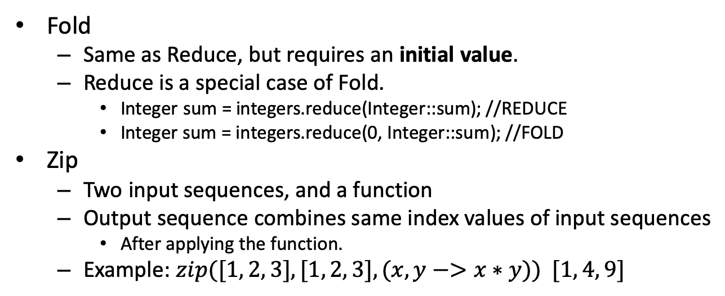
Higher Order Functions : More Functions
Fold
Same as Reduce, but requires an initial value.
Reduce is a special case of Fold.
Integer sum = integers.reduce(Integer::sum); //REDUCE
Integer sum = integers.reduce(0, Integer::sum); //FOLD
Zip
Two input sequences, and a function
Output sequence combines same index values of input sequences
After applying the function.
Example: $zip([1, 2, 3], [1, 2, 3], (x, y−>x∗y)) [1, 4, 9]$

Slide 90
Java Functional Programming Support
 | Functional Languages | Java Object Oriented | Java 8
Functions | Independent | Bound to class object, “methods” | Uses functional interface Independent but bound to object or class
Value State | Immutable | Mutable | Immutable if required
Function Chaining | Yes | Only if in same instance | Lambdas allow chaining
Concurrency and multicore support | Yes | Requires synchronization tools | Yes – if pure functional

Slide 91
Java Functional Interfaces
Interface | Input | Output | Purpose
Function | Single object of any type | Single object of any type | Apply logic on input, allow logic chaining
BiFunction | Two objects of any type | Single object of any type | Apply logic on both inputs, allow logic chaining
Predicate | Single object of any type | Boolean | Test if value conforms to Boolean logic
Consumer/BiConsumer | Single/double object of any type | None | Used a value and output, execute some side-effect
Supplier |  | Single object of any type | Create an object of desired type

Slide 92
Java Function Interface
Used for creating a an output object based on a given input and the logic and possibly chaining with other functions.
A logic can be packed as a variable.
public interface Function<T,R>
R apply(T t) | Applies logic to T and returns an object of R
andThen(Function after) | First applies its logic then the logic provided by Function after
compose(Function before) | First applies before logic then its own logic
identity() | Returns a function that always returns its input argument.

Slide 93
Executing a function using apply()
//defining a function receives String as input,
//returns Integer as output using lambda expression Function<String, Integer> findWordCount = in -> { return in.split(" ").length; }; //execute the implemented function using apply() System.out.println(
findWordCount.apply("this sentence has five words"));

Slide 94
Java Functional Composition
To compose two functions means to arrange them so that the result of one function is applied as the input of the other function
A technique to combine multiple functions into a single function
It uses the combined functions internally
Java comes with built-in support for functional composition
To make the job easier to combine functions

Slide 95
Incorrect Composition of Predicates
1 2 3 4 5 6 7 8 9 | Predicate<String> startsWithA = (text) -> text.startsWith("A"); Predicate<String> endsWithX = (text) -> text.endsWith("x"); Predicate<String> startsWithAAndEndsWithX = (text) -> startsWithA.test(text) && endsWithX.test(text); String input = "A hardworking person must relax"; boolean result = startsWithAAndEndsWithX.test(input); System.out.println(result);
This functional composition example first creates two Predicate implementations in the form of two lambda expressions.
The first Predicate returns true if the String you pass to it as parameter starts with an uppercase a (A).
The second Predicate returns true if the String passed to it ends with a lowercase x .
Note, that the Predicate interface contains a single unimplemented method named test() which returns a boolean.
It is this method the lambda expressions implement.

Slide 96
Java Predicate Composition Support
java.util.function.Predicate contains assisting method for predicate composition:
default Predicate<T> | and(Predicate<? super T> other) Returns a composed predicate that represents a short-circuiting logical AND of this predicate and another.
static <T> Predicate<T> | isEqual(Object targetRef) Returns a predicate that tests if two arguments are equal according to Objects.equals(Object, Object).
default Predicate<T> | negate() Returns a predicate that represents the logical negation of this predicate.
default Predicate<T> | or(Predicate<? super T> other) Returns a composed predicate that represents a short-circuiting logical OR of this predicate and another.
boolean | test(T t) Evaluates this predicate on the given argument.

Slide 97
Correct Composition of Predicates
1 2 3 4 5 6 7 8 | Predicate<String> startsWithA = (text) -> text.startsWith("A"); Predicate<String> endsWithX = (text) -> text.endsWith("x"); Predicate<String> composed = startsWithA.or(endsWithX); String input = "A hardworking person must relax sometimes"; boolean result = composed.test(input); System.out.println(result);
This Predicate or() functional composition example first creates two basic Predicate instances.
Second, the example creates a third Predicate composed from the first two,
by calling the or() method on the first Predicate
and passing the second Predicate as parameter to the or() method.
The output of running the above example will be true

Slide 98
Java Function Composition Support
java.util.function.Function contains a few methods that can be used to compose new Function instances from existing ones.
default <V> Function<T,V> | andThen(Function<? super R,? extends V> after) Returns a composed function that first applies this function to its input, and then applies the after function to the result.
R | apply(T t) Applies this function to the given argument.
default <V> Function<V,R> | compose(Function<? super V,? extends T> before) Returns a composed function that first applies the before function to its input, and then applies this function to the result.
static <T> Function<T,T> | identity() Returns a function that always returns its input argument.

Slide 99
Function Composition Example: Compose
The Function returned by compose() will first call the Function passed as parameter to compose()
and then it will call the Function which compose() was called on.
1 2 3 4 5 6 7 | Function<Integer, Integer> multiply = (value) -> value * 2; Function<Integer, Integer> add = (value) -> value + 3; Function<Integer, Integer> addThenMultiply = multiply.compose(add); Integer result1 = addThenMultiply.apply(3); System.out.println(result1);
When called with the value 3:
The composed Function will first call the add Function
and then the multiply Function.
The result of the calculation will be (3 + 3) * 2 =12.

Slide 100
Function Composition Example: andThen
andThen() method works opposite of the compose() method:
a.andThen(b) is the same as calling b.compose(a) .
A Function composed with andThen() will first call the Function that andThen() was called on,
and then it will call the Function passed as parameter to the andThen() method
1 2 3 4 5 6 7 | Function<Integer, Integer> multiply = (value) -> value * 2; Function<Integer, Integer> add = (value) -> value + 3; Function<Integer, Integer> multiplyThenAdd = multiply.andThen(add); Integer result2 = multiplyThenAdd.apply(3); System.out.println(result2);
andThen() method is called on the multiply Function to compose a new Function,
passing the add Function as parameter to andThen().
Calling the Function composed by andThen() with the value 3 will result in:
3 * 2 + 3 = 9.

Slide 101
Java Consumer/Supplier Interfaces
Two Interfaces that follow the producer-consumer paradigm.
Consumer<T>: (BiConsumer<T,R>)
Represents an operation that accepts a single input argument and returns no result.
Since the interface does not return a result, the item is ‘consumed’
Function: void accept(T t) (void accept(T t, U u))
Supplier<T>:
Represents a supplier of results.
Execution of get() generates T and returns it.
Function: T get()
Notes:
Consumer: https://docs.oracle.com/javase/8/docs/api/java/util/function/Consumer.html
Supplier: https://docs.oracle.com/javase/8/docs/api/java/util/function/Supplier.html
BiConsumer:
BiConsumer: https://docs.oracle.com/javase/8/docs/api/java/util/function/BiConsumer.html

Slide 102
Supplier/Consumer Example
//Supplier implemented to generate Fibonacci sequence Supplier<Long> fibonacciSupplier = new Supplier<Long>() { long n1 = 1; long n2 = 1; @Override public Long get() { long fibonacci = n1; long n3 = n2 + n1; n1 = n2; n2 = n3; return fibonacci; } }; //Consumer implemented to printout received values Consumer<Long> beautifulConsumer = o -> System.out.print(o + "\t"); //Stream uses Supplier to generate 50 items,
// and applies Consumer on each item using forEach Stream.generate(fibonacciSupplier).limit(50).forEach(beautifulConsumer);

Slide 103
Another Supplier Example
Supplier<Long> fibonacciSupplier = new Supplier<Long>() { long n1 = 1; long n2 = 1; @Override public Long get() { //this is not a pure function! long fibonacci = n1; long n3 = n2 + n1; n1 = n2; n2 = n3; return fibonacci; } }; for (int i=0;i<10;i++) //this will print first 10 numbers System.out.print(fibonacciSupplier.get() + "\t");
Notes:
This is not lazy evaluation! Just functional style.

Slide 104
Java Streams
Stream is the structure for processing a collection of objects in functional style
Original collection is not modified.
A Java Stream is a component that is capable of internal iteration of its elements, meaning it can iterate its elements itself.
In contrast, using Java Iterator or the Java for-each loop, the programmer have to implement the iteration process themselves
Every Collection type may be converted to Stream
Can be created with stream() method of Collection.
Streams can also be created from scratch.
Stream<Integer> s = Stream.of(3, 4, 5)
IntStream iStream = IntStream.range(1, 5);
Notes:
IntStream, DoubleStream, LongStream

Slide 105
Stream Processing
Stream may be processed only once.
After getting an output, the stream cannot be used again.
Processing is done by attaching listeners to a Stream.
These listeners are called when the Stream iterates the elements internally
The listeners of a stream form a chain:
The first listener in the chain can process the element in the stream,
and then return a new element for the next listener in the chain to process.
A listener can either return the same element or a new one
depending on what the purpose of that listener (processor) is.

Slide 106
Stream Characteristics
Processing streams lazily allows for significant efficiencies
Filtering, mapping, and summing can be fused into a single pass on the data with minimal intermediate state.
Laziness also allows avoiding examining all the data when it is not necessary.
Example: "find the first string longer than 1000 characters“
Need to examine just enough strings to find one that has the desired characteristics
Without examining all of the strings available from the source.
This behavior becomes even more important when the input stream is infinite and not merely large.

Slide 107
Java Streams: Example
// Create an ArrayList List<Integer> myList = new ArrayList<Integer>(); myList.add(1); myList.add(5); myList.add(8); // Convert it into a Stream Stream<Integer> myStream = myList.stream();
Notes:
// Create an array
Integer[] myArray = {1, 5, 8};
// Convert it into a Stream
Stream<Integer> myStream = Arrays.stream(myArray);

Slide 108
Java Streams: Pipeline
Stream operations are combined to form stream pipelines.
Source -> Intermediate Operations -> Terminal Operation
A stream pipeline begins with a source
Such as a Collection, an array, a generator function, or an I/O channel
Followed by zero or more intermediate operations
These operations yield a new Stream as a result.
Such as Stream.filter or Stream.map
And ending with a terminal operation
These operations yield a result that is not a Stream
Such as Stream.forEach or Stream.reduce.

Slide 109
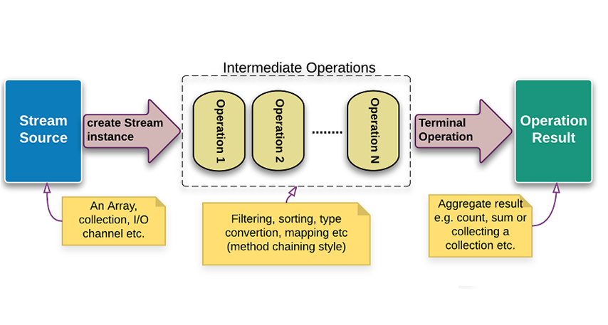
Java Streams Pipeline

Slide 110
Java Stream Creation
From Arrays:
From Collections:
Using generate():
static <T> Stream<T> of(T t)
Stream<String> stream = Stream.of(“this", “is", “a", “string", “stream", “in", “Java");
default Stream<E> stream()
List<String> list = new ArrayList<String>(); list.add("java"); list.add("php"); list.add("python"); Stream<String> stream = list.stream();
static <T> Stream<T> generate(Supplier<T> s)
Stream<String> stream = Stream.generate(() -> "test").limit(10);

Slide 111
More Java Stream Creation
Using iterate():
Using APIs:
Static <T> Stream<T> iterate(T seed, UnaryOperator<T> f)
Stream<BigInteger> bigIntStream = Stream.iterate( BigInteger.ZERO, n -> n.add(BigInteger.ONE)); bigIntStream.limit(100).forEach(System.out::println);
public Stream<String> splitAsStream(CharSequence input)
String sentence = “This is a six word sentence.";
Stream<String> wordStream = Pattern.compile("\\W")
.splitAsStream(sentence);
Notes:
BigInteger is a class that can store integers larger than 64bit. Has no maximum limit! It is immutable and mostly slower than regular integer objects
\\W – no-word character

Slide 112
‘Reusing’ of Streams
Streams can be ‘reused’ by wrapping them with a Supplier.
Streams are not really reused but instead are conveniently re-created
Each time we get(), a new stream is provided.
Cannot pause and resume operations on same stream.
Problem:
Solution:
Stream<String> stream = Stream.of("d2", "a2", "b1", "b3", "c") .filter(s -> s.startsWith("a")); stream.anyMatch(s -> true); // ok stream.noneMatch(s -> true); // exception
Supplier<Stream<String>> streamSupplier = () -> Stream.of("d2", "a2", "b1", "b3", "c")
.filter(s -> s.startsWith("a")); System.out.println(streamSupplier.get().anyMatch(s -> true)); //true System.out.println(streamSupplier.get().noneMatch(s -> true)); //false

Slide 113
Intermediate Operations Characteristics
Any operation is denoted as an intermediate operation if it return a new Stream.
These operations create a new Stream that contains the elements of the initial Stream that match the given Predicate.
Example: Stream.filter does not perform any real filtering!
Intermediate operations are always lazy.
Traversal of the pipeline source does not begin until the terminal operation of the pipeline is executed.

Slide 114
Intermediate Operations
Stream Operation | Purpose | Input
filter | Filters item according to a predicate | Predicate
map/flatMap | Applies function on stream items | Function
limit | Returns first n elements of stream | int
sorted | Sort stream items | Comparator
distinct | Discards duplicates using equals method
Reduce/Fold | Applies function on all of the stream | BinaryOperator
peek | Returns a copy of stream then applies Consumer function on result | Consumer
skip | Discard first n elements of result stream | Long
Notes:
flatMap combines the results, where map does not
Fold is a special case where user can provide an initial value, while reduce does not have an initial value.

Slide 115
Java Example: Map
//make a new stream String[] myArray = new String[]{"bob", "alice", "paul", "ellie"}; Stream<String> myStream = Arrays.stream(myArray);
//convert to upper case Stream<String> myNewStream = myStream.map(s -> s.toUpperCase());
//convert back to array of strings String[] myNewArray = myNewStream.toArray(String[]::new);
Notes:
java.util.Arrays class can be used to generate a stream from an array object.

Slide 116
Java Example: Filter
//make a new array of strings String[] myArray = new String[]{"bob", "alice", "paul", "ellie"};
//convert to stream, filter, and convert back to array of strings String[] myNewArray = Arrays.stream(myArray) .filter(s -> s.length() > 4) .toArray(String[]::new);
Notes:
Filtering creates a new stream. The original stream remains untouched.

Slide 117
Java Example: Reduce
//make a new array of strings List<String> myArray = Arrays.asList("bob", "alice", "paul", "ellie");
//convert to stream, map to int, reduce to min, printout System.out.println(myArray.stream() .map(s -> s.length()) .reduce(Integer::min).get());
Output? 3
Notes:
map() – maps each string to its length value
reduce() – applies ‘min’ on the stream returning “Optional<T>”.
which we get() the value from it.

Slide 118
Java Example: Fold
//make a new array of strings List<String> myArray = Arrays.asList("bob", "alice", "paul", "ellie");
//convert to stream, map to int, reduce to min between 0
//and min string length, printout System.out.println(myArray.stream() .map(s -> s.length()) .reduce(1, Integer::min));
Output? 1
Notes:
Fold does the same thing as reduce but adds to it an initial value.
You can look at Reduce as a special case of Fold.
In Java, Reduce and Fold are implemented under “reduce”
Fold accepts two parameters, while reduce accepts one.

Slide 119
Java: FlatMap
This is a combination of applying a “map” function, then flattening the result by one level.
Effect of FlatMap on stream structure:
Effect of FlatMap on stream data:
Stream<String[]> -> flatMap -> Stream<String>
Stream<Set<String>> -> flatMap -> Stream<String>
Stream<List<String>> -> flatMap -> Stream<String>
Stream<List<Object>> -> flatMap -> Stream<Object>
{ {1,2}, {3,4}, {5,6} } -> flatMap -> {1,2,3,4,5,6}
{ {'a','b'}, {'c','d'}, {'e','f'} } -> flatMap -> {'a','b','c','d','e','f'}
Notes:
FlatMap applies Map on each item of the stream, and the result is flattened.

Slide 120
Java Example: FlatMap
Let’s say we have a Student object which contains:
Student Name – String
Set of Book names owned by the student – Set<String>
Data Structure Population:
We create two student objects and adding books for each student.
Then add them to a list of Students.
Query we wish to implement:
Get the list of distinct books names the students possess.

Slide 121
FlatMap Example: Student Class
1 2 3 4 5 6 7 8 9 10 11 12 13 | public class Student { private String name; private List<String> book; public void addBook(String book) { if (this.books == null) { this.books = new ArrayList<>(); } this.books.add(book); } public Set<String> getBooks(){ return book; } }

Slide 122
FlatMap Example: Creating students and population the list
Student std1 = new Student();
std1.setName(“John");
std1.addBook("Java 8 in Action");
std1.addBook("Spring Boot in Action");
std1.addBook("Effective Java (2nd Edition)");
Student std2 = new Student();
std2.setName(“Mark");
std2.addBook("Learning Python, 5th Edition");
std2.addBook("Effective Java (2nd Edition)");
List<Student> list = new ArrayList<>();
list.add(std1); list.add(std2);

Slide 123
FlatMap Example: Executing the Query
List<String> result = list.stream()
.map(x -> x.getBooks()) //Stream<List<String>>
.flatMap(x -> x.stream()) //Stream<String>
.distinct()
.collect(Collectors.toList());
result.forEach(x -> System.out.println(x));
Output:
Spring Boot in Action
Effective Java (2nd Edition)
Java 8 in Action
Learning Python, 5th Edition
Notes:
x.stream() generates a stream from a Set<String>
Applying flatMap will apply map on each item and asking from each Set<String> its stream() and them flattening them into one Stream of Strings

Slide 124
Termination Operations
These operations traverse the stream to produce a result or a side-effect.
After the terminal operation is performed, the stream pipeline is considered consumed, and can no longer be used!
If you need to traverse the same data source again
you must return to the data source to get a new stream.
Examples of termination operations:
Stream.forEach
IntStream.sum

Slide 125
Termination Operations
Stream Operation | Purpose | Input
forEach | For each item, apply Consumer function | Consumer
count | Count stream items
collect | Reduces stream into a desired collection | Collector
min/max | Returns min/max element according to Compartor | Comparator
anyMatch/allMatch/noneMatch | Returns whether any/all/none elements of stream match the provided predicate. | Predicate
findFirst/findAny | Returns Optional containing first/any result
Notes:
anyMatch – any of the elements fulfill the predicate are returned
allMatch – all of the elements must fulfill the predicate, otherwise not returned.
noneMatch – none of elements fulfill predicate, otherwise not returned
findAny – returns a result following maximal performance in parallel operations
Complete API: https://docs.oracle.com/javase/8/docs/api/java/util/stream/Stream.html

Slide 126
collect() using Collectors
Collector is a reducer operation
Takes a sequence of input elements and combines them into a single summary result.
Result may be one single collection or any type of one object instance
Collectors can:
accumulates the input elements into a new List:
.collect(Collectors.toList())
Accumulates the input elements into any container:
.collect(Collectors.toCollection(ArrayList::new));
More in next slide.

Slide 127
Collectors – Part of API
Collectors.toList() | Puts items into a list
Collectors.toCollection(TreeSet::new) | Puts items into a desired container. Container is supplied with a supplier
Collectors.joining(", “) | Joins multiple items into a single item by concatenating them
Collectors.summingInt(item::getAge) | Sums the values of each item with given supplier
Collectors.groupingBy() | Groups the items with given classifier and mapper – results in as many groups as needed
Collectors.partitioningBy() | Partitions the items with given predicate and mapper – results in two groups only!
Notes:
https://docs.oracle.com/javase/8/docs/api/java/util/stream/Collectors.html

Slide 128
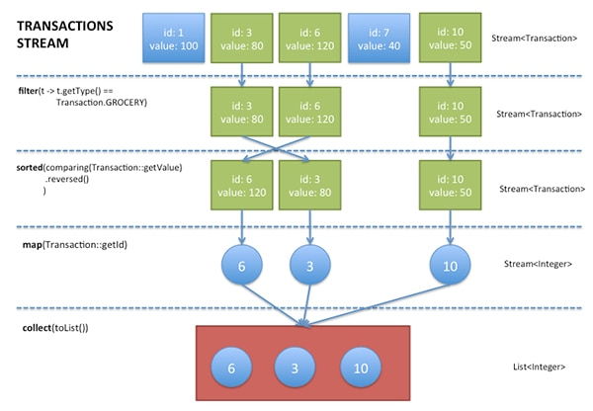
Stream Pipeline: Example

Slide 129
Using Streams Example: Company Employees
public class Employee { private String name; private String department; private int salary; public Employee(String name, String department, int salary){ this.name = name; this.department = department; this.salary = salary; } public int getSalary(){ return salary; } public String getDepartment(){ return department; } }

Slide 130
Two Departments, 2 Employees in each one
List<Employee> company = new ArrayList<>(); company.add(new Employee(new String("Emp1"), new String("HR"), 3000)); company.add(new Employee(new String("Emp2"), new String("HR"), 2000)); company.add(new Employee(new String("Emp3"), new String("Admin"), 5000)); company.add(new Employee(new String("Emp4"), new String("Admin"), 4000));

Slide 131
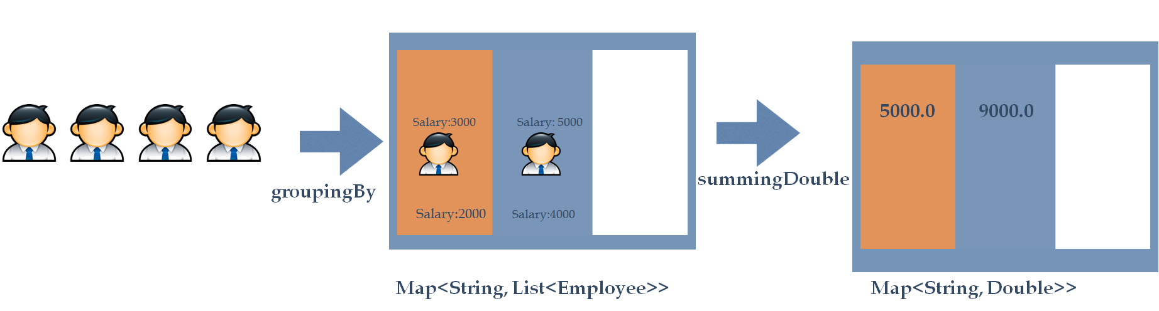
groupingBy(): Find total salary cost for each department

Slide 132
Print out department name, salary cost
company.stream() .collect(Collectors.groupingBy(Employee::getDepartment, Collectors.summingDouble(Employee::getSalary))) .forEach((s, d) -> System.out.println("Department: " + s + "\tTotal Salary: " + d));

Slide 133
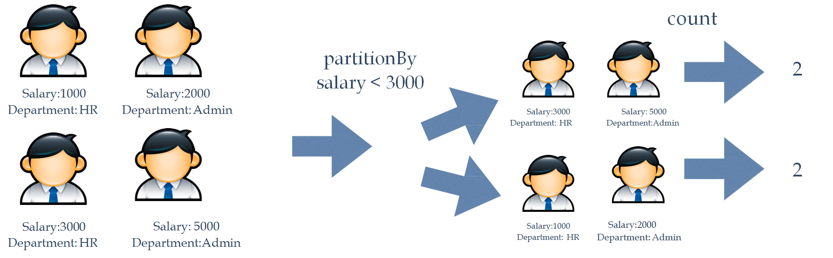
partitionBy(): Find Number of employees with salary less than 3000

Slide 134
Print out two groups: true, false, and their sizes
company.stream() .collect(Collectors.partitioningBy(e -> e.getSalary() < 3000, Collectors.counting())) .forEach((s, d) -> System.out.println("Group: " + s + "\tTotal Employees: " + d));

Slide 135
peek() operation
Returns a stream consisting of the elements of this stream.
It also performs the provided action on each element from the resulting stream.
This function is used mainly to support debugging
API: Stream<T> peek(Consumer)
Stream.of("one", "two", "three", "four") .filter(e -> e.length() > 3) .peek(e -> System.out.println("Filtered value: " + e)) .map(String::toUpperCase) .peek(e -> System.out.println("Mapped value: " + e)) .collect(Collectors.toList());

Slide 136
Java Optional Interface
//make a new array of strings List<String> myArray = Arrays.asList("bob", "alice", "paul", "ellie");
//convert to stream, map to int, reduce to min between 0 and min string length, printout Optional<String> result = myArray.stream() .filter(s -> s.length() > 4) .findFirst();
if (result.isPresent()) System.out.println(result.get());
“result” may contain and may not contain a non-null value!
Sometimes, filters may return “no result” as a result.
The use of Optional here will assist us to check whether a value is returned.
Null checks “litter” code, and it is frowned upon.
Java 8 provides this special object and encourages this best-practice over null checks.

Slide 137
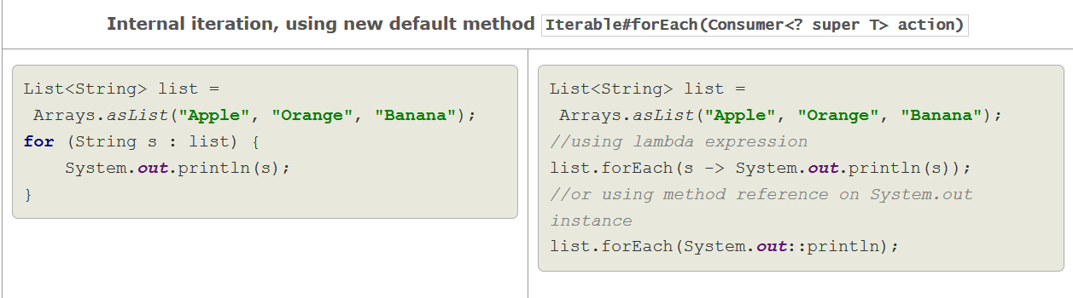
Java Imperative vs Java Declarative: 1

Slide 138
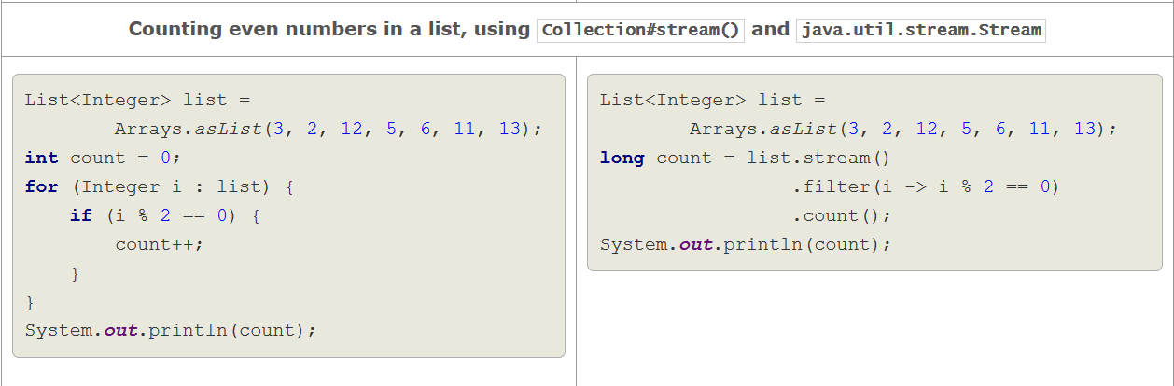
Java Imperative vs Java Declarative: 2

Slide 139
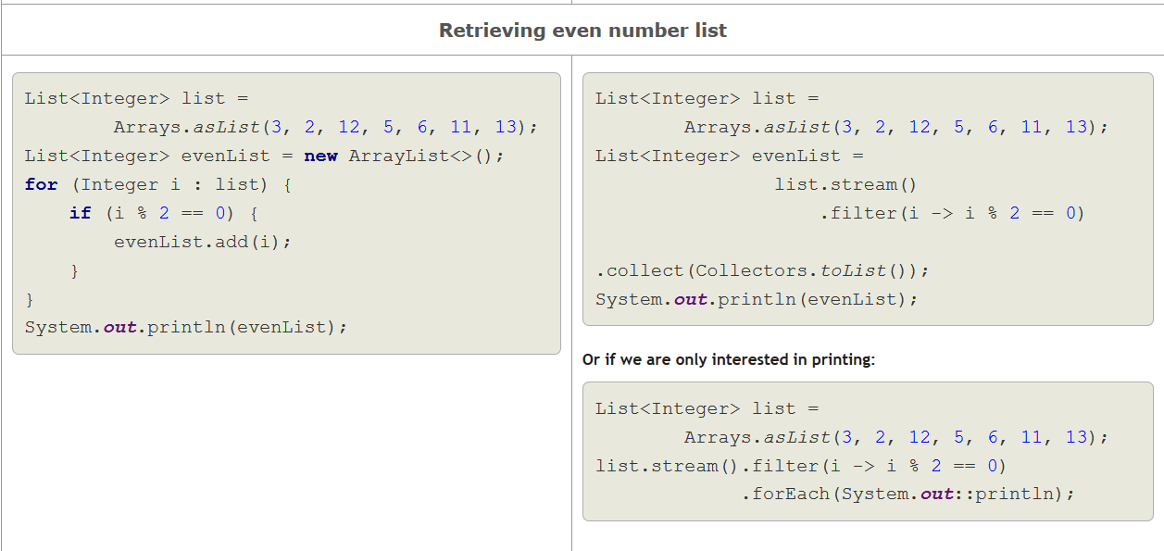
Java Imperative vs Java Declarative: 3

Slide 140
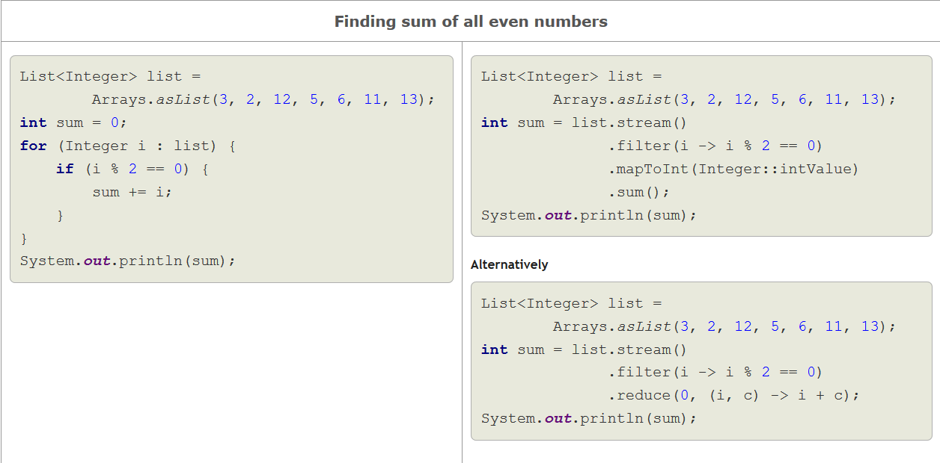
Java Imperative vs Java Declarative: 4

Slide 141
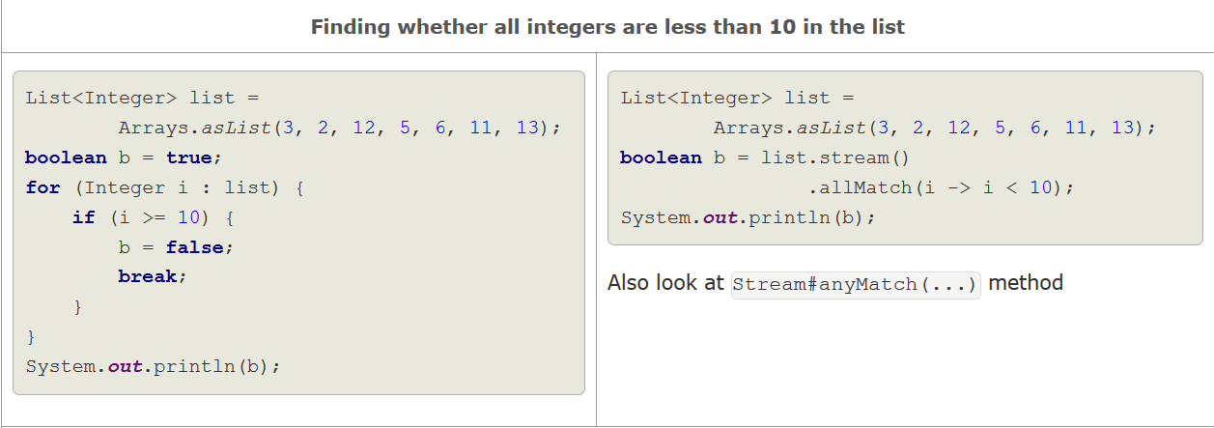
Java Imperative vs Java Declarative: 5

Slide 142
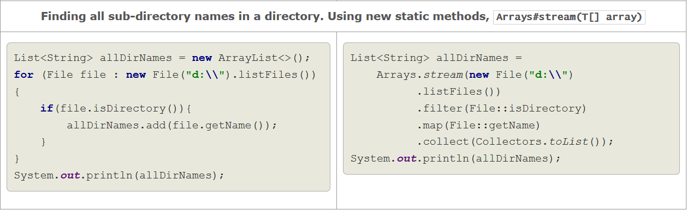
Java Imperative vs Java Declarative: 6

Slide 143
Java Parallel Streams
Parallel Computing:
Divide a problem into sub-problems
Solving those problems simultaneously
in parallel, with each sub-problem running in a separate thread
The results of the solutions to the sub-problems are then combined
Java Requirements:
One must specify how the problems are sub-divided (partitioned).
Must define the aggregate operations
Then Java runtime performs the partitioning and combining of solutions automatically following the definitions

Slide 144
Executing Streams in Parallel
To create a parallel stream from a collection:
Use Collection.parallelStream()
Convert a serial stream to parallel stream:
Use BaseStream.parallel()
Example: the following statement calculates the average age of all male members in parallel
1 2 3 4 5 6 | double average = roster .parallelStream() .filter(p -> p.getGender() == Person.Sex.MALE) .mapToInt(Person::getAge) .average() .getAsDouble();
Notes:
roster is a collection

Slide 145
Concurrent Reduction
Concurrently apply a reduction function on the parallel stream
The Java runtime performs a concurrent reduction if all of the following are true for a particular pipeline that contains the collect operation:
The stream is parallel.
The parameter of the collect operation, the collector, has the characteristic Collector.Characteristics.CONCURRENT.
Example: ConcurrentHashmap
Either the stream is unordered, or the collector has the characteristic Collector.Characteristics.UNORDERED.
Example: Set, data source is unordered
Notes:
To determine the characteristics of a collector, invoke the Collector.characteristics method:
Indicates that this collector is concurrent, meaning that the result container can support the accumulator function being called concurrently with the same result container from multiple threads.
To ensure that the stream is unordered, invoke the BaseStream.unordered operation.
Indicates that the collection operation does not commit to preserving the encounter order of input elements. (This might be true if the result container has no intrinsic order, such as a Set.)

Slide 146
Concurrent Reduction: Example
Regular Reduction:
1 2 3 4 5 | Map<Person.Sex, List<Person>> byGender = roster .stream() .collect(Collectors.groupingBy(Person::getGender));
Concurrent Reduction:
1 2 3 4 5 | ConcurrentMap<Person.Sex, List<Person>> byGender = roster .parallelStream() .collect( Collectors.groupingByConcurrent(Person::getGender));

Slide 147
Ordering Issues: Parallel Streams
The elements process order depends on:
Whether the stream is executed in serial or in parallel
The source of the stream
The intermediate operations
Example: Consider the example that prints the elements of an instance of ArrayList with the forEach operation several times:
1 2 3456 | Integer[] intArray = {1, 2, 3, 4, 5, 6, 7, 8 }; List<Integer> listOfIntegers = new ArrayList<>(Arrays.asList(intArray)); System.out.println("listOfIntegers:"); listOfIntegers.stream() .forEach(e -> System.out.print(e + " ")); System.out.println("");

Slide 148
Ordering: Serial vs Parallel Stream
Serial Stream: [multiple executions return same results]
1 2 3 4 5 | System.out.println(“Serial stream"); listOfIntegers.stream() .forEach(e -> System.out.print(e + " ")); System.out.println("");
Parallel Stream: [multiple executions return different results]
1 2 3 4 5 | System.out.println(“Parallel stream"); listOfIntegers.parallelStream() .forEach(e -> System.out.print(e + " ")); System.out.println("");

Slide 149
Ordering: Stream source order
Source order is reversed, output result is different:
1 2 3 4 5 6 7 8 | System.out.println("listOfIntegers sorted in reverse order:"); Comparator<Integer> normal = Integer::compare; Comparator<Integer> reversed = normal.reversed(); Collections.sort(listOfIntegers, reversed); listOfIntegers.stream() .forEach(e -> System.out.print(e + " ")); System.out.println("");

Slide 150
Ordering: Intermediate operations effect
Some intermediate operations alter the order of elements:
1 2 3 4 5 | System.out.println("With forEachOrdered:"); listOfIntegers.parallelStream() .forEachOrdered(e -> System.out.print(e + " ")); System.out.println("");

Slide 151
Stateful Lambda and Lambda Interference
These issues effect both serial and parallel streams!
Lambda expressions must not have a state
A stateful lambda expression is one whose result depends on a state that might change during the execution of a pipeline
Lambda expressions in stream operations must not interfere.
Interference occurs when the source of a stream is modified while a pipeline processes the stream.
Notes:
ConcurrentModificationException is thrown

Slide 152
Stateful Lambda: Serial Stream Example
1 2 3 4 5 6 7 8 9 10 11 12 13 14 15 | List<Integer> serialStorage = new ArrayList<>(); System.out.println("Serial stream:"); listOfIntegers .stream() .map(e -> { serialStorage.add(e); return e; }) .forEachOrdered(e -> System.out.print(e + " ")); System.out.println(""); serialStorage .stream() .forEachOrdered(e -> System.out.print(e + " ")); System.out.println("");
Notes:
Problems in line: 6

Slide 153
Stateful Lambda: Parallel Stream Example
1 2 3 4 5 6 7 8 9 10 11 12 13 14 | List<Integer> serialStorage = new ArrayList<>(); System.out.println("Parallel stream:"); List<Integer> parallelStorage = Collections.synchronizedList(new ArrayList<>()); listOfIntegers .parallelStream .map(e -> { parallelStorage.add(e); return e; }) .forEachOrdered(e -> System.out.print(e + " ")); System.out.println(""); parallelStorage .stream() .forEachOrdered(e -> System.out.print(e + " ")); System.out.println("");
Notes:
Issues in line: 7
The lambda expression e -> { parallelStorage.add(e); return e; } is a stateful lambda expression. Its result can vary every time the code is run. This example prints the following:
Serial stream: 8 7 6 5 4 3 2 1 8 7 6 5 4 3 2 1 Parallel stream: 8 7 6 5 4 3 2 1 1 3 6 2 4 5 8 7

Slide 154
Lambda Interference: Example
1 2 3 4 5 6 7 8 9 10 11 | try { List<String> listOfStrings = new ArrayList<>(Arrays.asList("one", "two")); String concatenatedString = listOfStrings .stream() .peek(s -> listOfStrings.add("three")) .reduce((a, b) -> a + " " + b) .get(); System.out.println("Concatenated string: " + concatenatedString); } catch (Exception e) { System.out.println("Exception caught: " + e.toString()); }
This will fail as the peek operation will attempt to add the string "three" to the source after the terminal operation has commenced!
This code will throw ConcurrentModificationException
Notes:
Example: This code attempts to concatenate the strings contained in the List listOfStrings. However, it throws an exception

Slide 155
Base64
With Java 8, Base64 has finally got its due. Java 8 now has inbuilt encoder and decoder for Base64 encoding. In Java 8, we can use three types of Base64 encoding.
Simple − Output is mapped to a set of characters lying in A-Za-z0-9+/. The encoder does not add any line feed in output, and the decoder rejects any character other than A-Za-z0-9+/.
URL − Output is mapped to set of characters lying in A-Za-z0-9+_. Output is URL and filename safe.
MIME − Output is mapped to MIME friendly format. Output is represented in lines of no more than 76 characters each, and uses a carriage return '\r' followed by a linefeed '\n' as the line separator. No line separator is present to the end of the encoded output.
Notes:
import java.util.Base64;
import java.util.UUID;
import java.io.UnsupportedEncodingException;
public class HelloWorld {
public static void main(String args[]) {
try {
// Encode using basic encoder
String base64encodedString = Base64.getEncoder().encodeToString(
"Cognixia.com?java8".getBytes("utf-8"));
System.out.println("Base64 Encoded String (Basic) :" + base64encodedString);
// Decode
byte[] base64decodedBytes = Base64.getDecoder().decode(base64encodedString);
System.out.println("Original String: " + new String(base64decodedBytes, "utf-8"));
base64encodedString = Base64.getUrlEncoder().encodeToString(
"Cognixia.com?java8".getBytes("utf-8"));
System.out.println("Base64 Encoded String (URL) :" + base64encodedString);
StringBuilder stringBuilder = new StringBuilder();
for (int i = 0; i < 10; ++i) {
stringBuilder.append(UUID.randomUUID().toString());
}
byte[] mimeBytes = stringBuilder.toString().getBytes("utf-8");
String mimeEncodedString = Base64.getMimeEncoder().encodeToString(mimeBytes);
System.out.println("Base64 Encoded String (MIME) :" + mimeEncodedString);
} catch(UnsupportedEncodingException e) {
System.out.println("Error :" + e.getMessage());
}
}
}

Slide 156
Java Date and Time
Java 8 introduces a new date-time API under the package java.time.
Following are some of the important classes introduced in java.time package.
Local − Simplified date-time API with no complexity of timezone handling.
Zoned − Specialized date-time API to deal with various timezones.
Notes:
public class LocalDateTimeTest {
public static void main(String args[]) {
LocalDateTimeTest localDateTime = new LocalDateTimeTest();
localDateTime.testLocalDateTime();
}
public void testLocalDateTime() {
// Get the current date and time
LocalDateTime currentTime = LocalDateTime.now();
System.out.println("Current DateTime: " + currentTime);
LocalDate date1 = currentTime.toLocalDate();
System.out.println("date1: " + date1);
Month month = currentTime.getMonth();
int day = currentTime.getDayOfMonth();
int seconds = currentTime.getSecond();
System.out.println("Month: " + month +" day: " + day +" seconds: " + seconds);
LocalDateTime date2 = currentTime.withDayOfMonth(10).withYear(2018);
System.out.println("date2: " + date2);
//12 december 2014
LocalDate date3 = LocalDate.of(2018, Month.DECEMBER, 22);
System.out.println("date3: " + date3);
//22 hour 15 minutes
LocalTime date4 = LocalTime.of(22, 15);
System.out.println("date4: " + date4);
//parse a string
LocalTime date5 = LocalTime.parse("20:15:30");
System.out.println("date5: " + date5);
}
}

Slide 157
LocalDateTime
public class LocalDateTimeTest {
public static void main(String args[]) {
LocalDateTimeTest localDateTime = new LocalDateTimeTest();
localDateTime.testLocalDateTime();
}
public void testLocalDateTime() {
// Get the current date and time
LocalDateTime currentTime = LocalDateTime.now();
System.out.println("Current DateTime: " + currentTime);
LocalDate date1 = currentTime.toLocalDate();
System.out.println("date1: " + date1);
Month month = currentTime.getMonth();
int day = currentTime.getDayOfMonth();
int seconds = currentTime.getSecond();
System.out.println("Month: " + month +" day: " + day +" seconds: " + seconds);
LocalDateTime date2 = currentTime.withDayOfMonth(10).withYear(2018);
System.out.println("date2: " + date2);
//12 december 2014
LocalDate date3 = LocalDate.of(2018, Month.DECEMBER, 22);
System.out.println("date3: " + date3);
//22 hour 15 minutes
LocalTime date4 = LocalTime.of(22, 15);
System.out.println("date4: " + date4);
}
}
Notes:
import java.util.ArrayList;
import java.util.List;
public class ParallelStream {
public static void main(String[] args) {
List < Employee > empList = new ArrayList < Employee > ();
for (int i = 0; i < 300; i++) {
empList.add(new Employee("A", 20000));
empList.add(new Employee("B", 3000));
empList.add(new Employee("C", 15002));
empList.add(new Employee("D", 7856));
empList.add(new Employee("E", 200));
empList.add(new Employee("F", 50000));
}
long t1 = System.currentTimeMillis();
System.out.println("Sequential Stream count: " + empList.stream().filter(e -> e.getSalary() > 15000).count());
long t2 = System.currentTimeMillis();
System.out.println("Sequential Stream Time taken:" + (t2 - t1));
t1 = System.currentTimeMillis();
System.out.println("Parallel Stream count: " + empList.parallelStream().filter(e -> e.getSalary() > 15000).count());
t2 = System.currentTimeMillis();
System.out.println("Parallel Stream Time taken:" + (t2 - t1));
}
}

Slide 158
ZoneDateTime
public class ZonedDateTimeTest {
public static void main(String args[]) {
ZonedDateTimeTest zonedDateTimeTest = new ZonedDateTimeTest();
zonedDateTimeTest.testZonedDateTime();
}
public void testZonedDateTime() {
// Get the current date and time
ZonedDateTime date1 = ZonedDateTime
.parse("2018-12-28T10:15:30+05:30[Asia/Kolkata]");
System.out.println("date1: " + date1);
//converts timezones
ZoneId id = ZoneId.of("Europe/Paris");
System.out.println("ZoneId: " + id);
ZonedDateTime parisDateTime =
date1.toInstant().atZone(id);
System.out.println(parisDateTime);
//adds four days
ZonedDateTime newZoneDateTime =
date1.plus(Period.ofDays(4));
System.out.println(newZoneDateTime);
//your currentzone
ZoneId currentZone = ZoneId.systemDefault();
System.out.println("CurrentZone: " + currentZone);
}
}
Notes:
import java.util.ArrayList;
import java.util.List;
public class ParallelStream {
public static void main(String[] args) {
List < Employee > empList = new ArrayList < Employee > ();
for (int i = 0; i < 300; i++) {
empList.add(new Employee("A", 20000));
empList.add(new Employee("B", 3000));
empList.add(new Employee("C", 15002));
empList.add(new Employee("D", 7856));
empList.add(new Employee("E", 200));
empList.add(new Employee("F", 50000));
}
long t1 = System.currentTimeMillis();
System.out.println("Sequential Stream count: " + empList.stream().filter(e -> e.getSalary() > 15000).count());
long t2 = System.currentTimeMillis();
System.out.println("Sequential Stream Time taken:" + (t2 - t1));
t1 = System.currentTimeMillis();
System.out.println("Parallel Stream count: " + empList.parallelStream().filter(e -> e.getSalary() > 15000).count());
t2 = System.currentTimeMillis();
System.out.println("Parallel Stream Time taken:" + (t2 - t1));
}
}

Slide 159
www.cognixia.com

